Slide 1
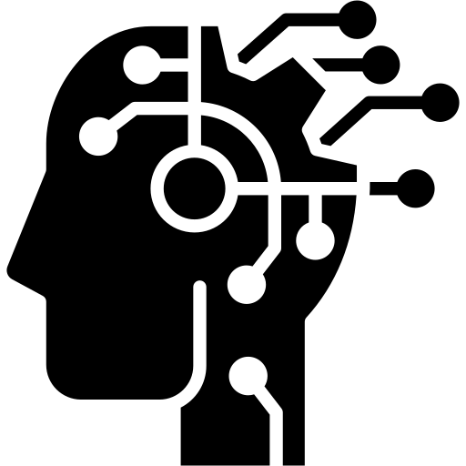

ANATOMY of AI
Prediction, Context, Real-World Usages in .NET
Alper Ebiçoğlu
Co-Founder of Volosoft
/alperebicoglu

Slide 2
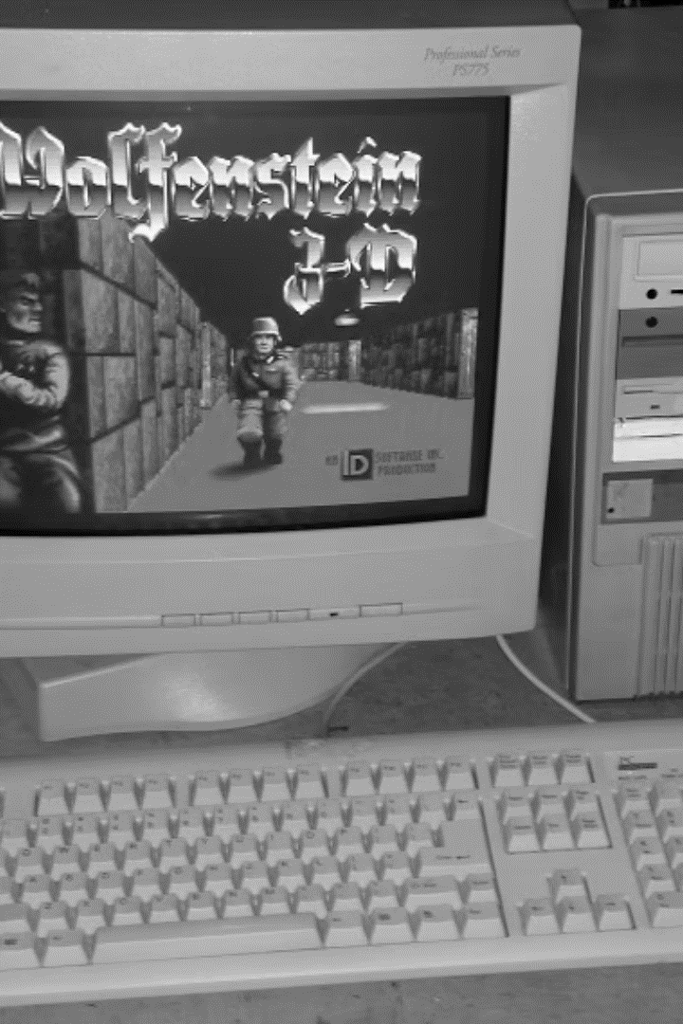
1997
Intel i386 processor with Q-Basic programming
2004
First .NET App developed on .NET Framework 1.0
2006
Computer Engineering
2010
Master Degree
2017
Co-Founder of Volosoft

Slide 3
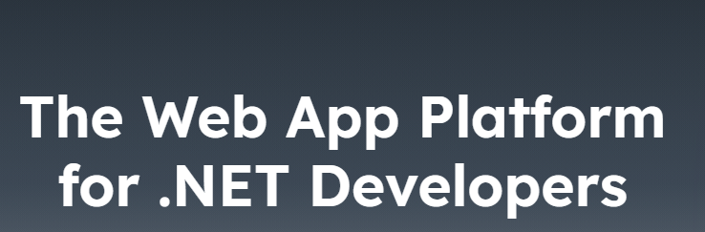
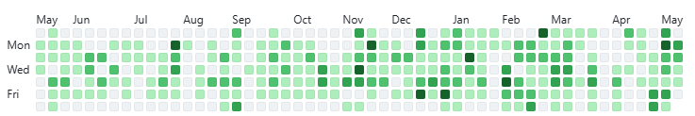

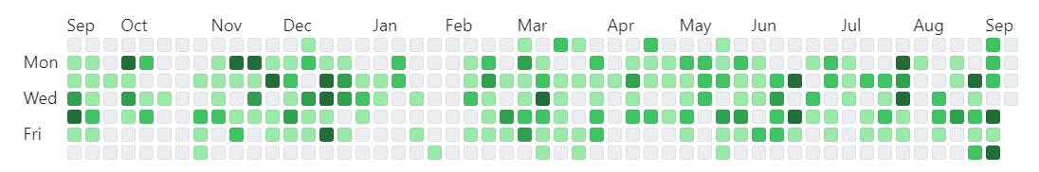
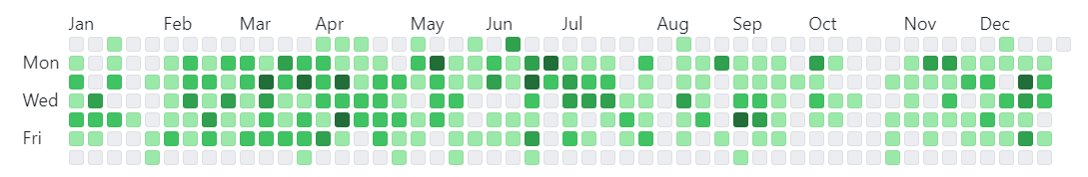
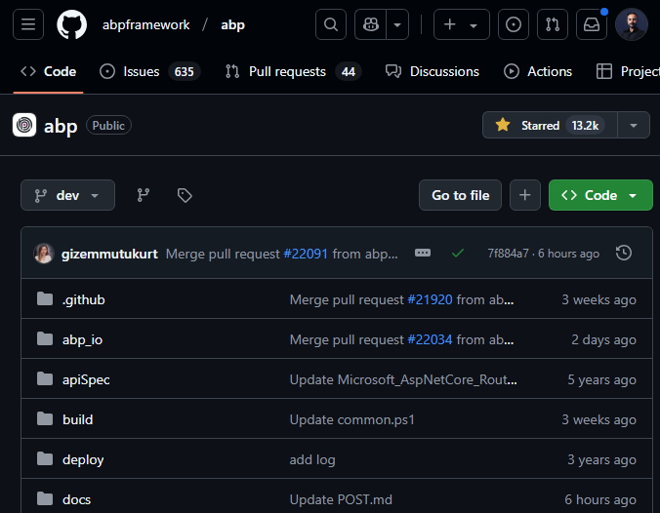
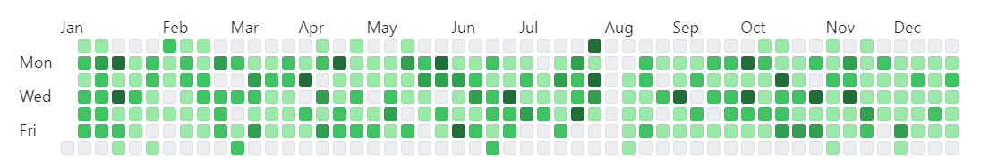

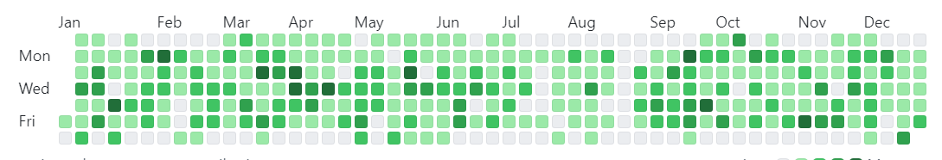
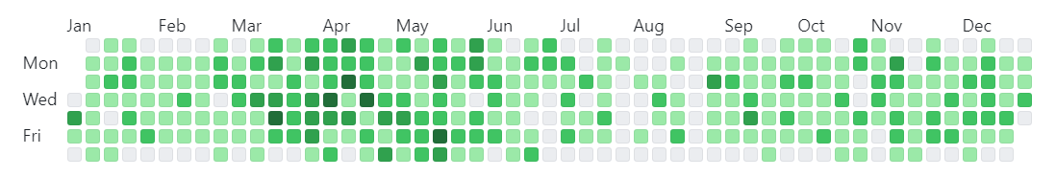
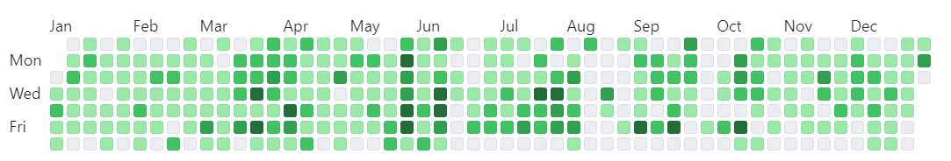
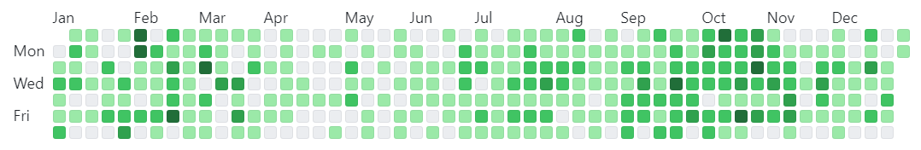
2025
2024
2023
2022
2021
2020
2019
2018

Slide 4
Agenda
First steps of AI
How AI Works…
.NET Demos, Chatbot

Slide 5
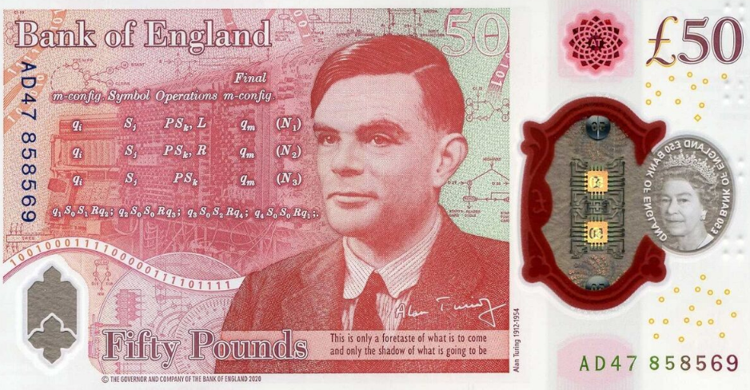
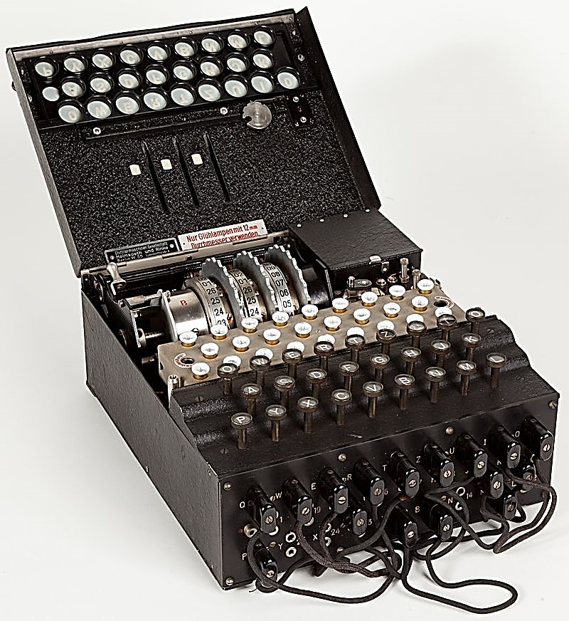
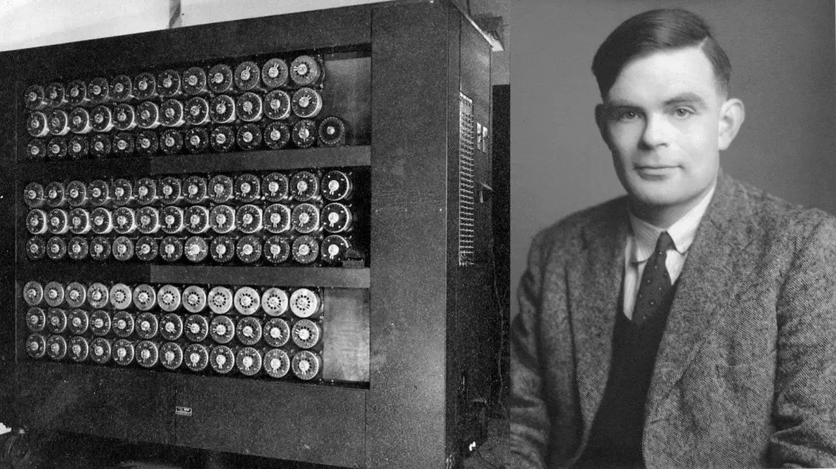
Alan Turing (1956) – The birth of AI
Enigma
Turing Machine
Alan Turing
“What we want is a machine that can learn from experience”
—Alan Turing, 1947, London.

Slide 6
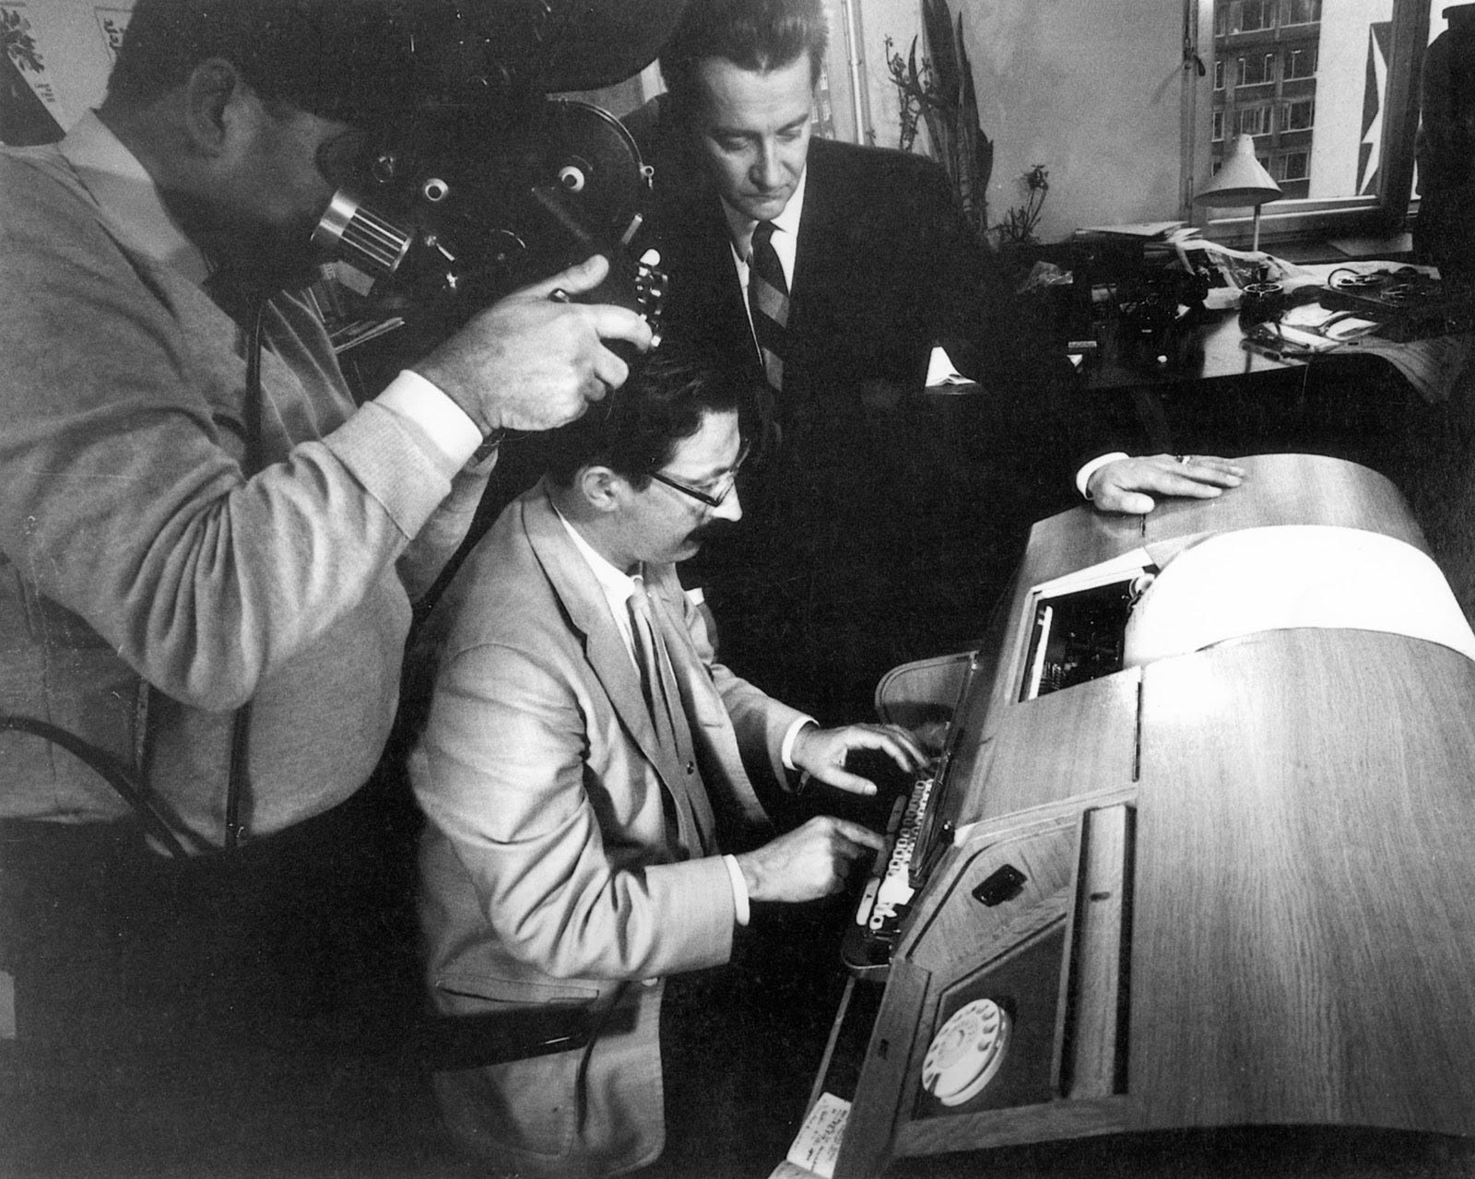
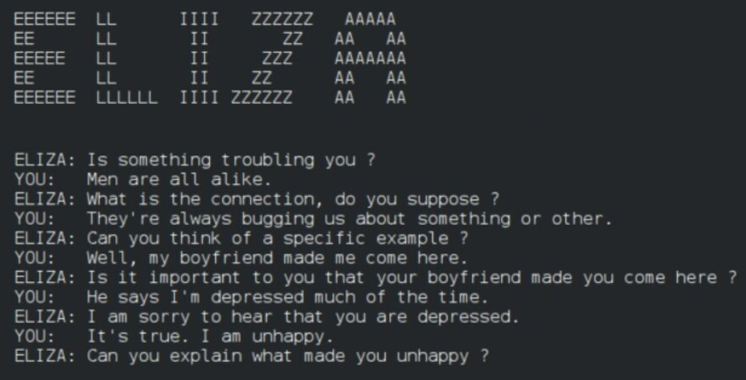
Eliza (1966) – First chatbot
Joseph Weizenbaum, 1965, MIT
Written in SLIP language

Slide 7
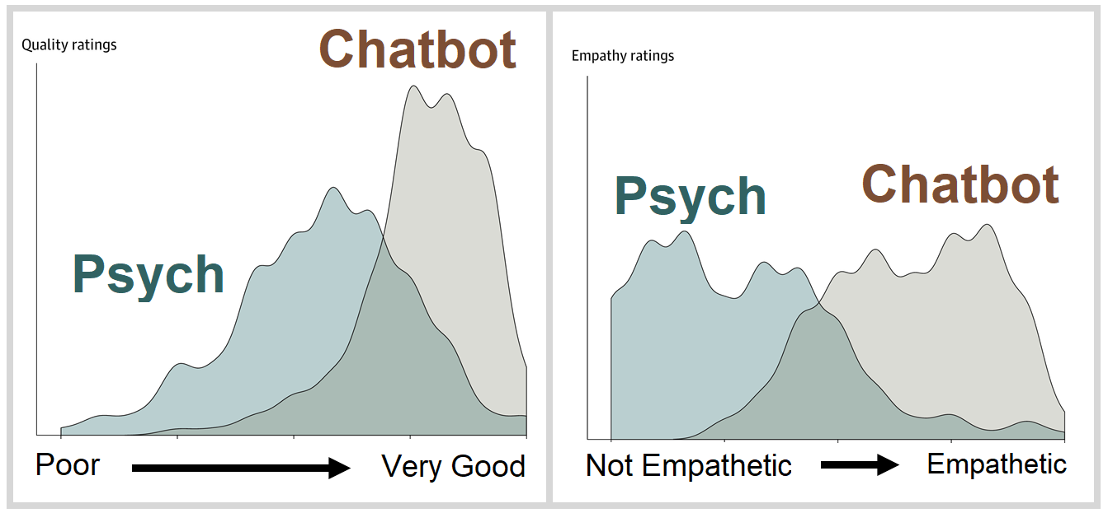
Distribution of Average Quality and Empathy Ratings for Chatbot and Physician Responses to Patient Questions (2023) John W. Ayers, PhD, MA, Qualcomm Institute, University of California San Diego

Slide 8

1- Eliza .NET Implementation

Slide 9
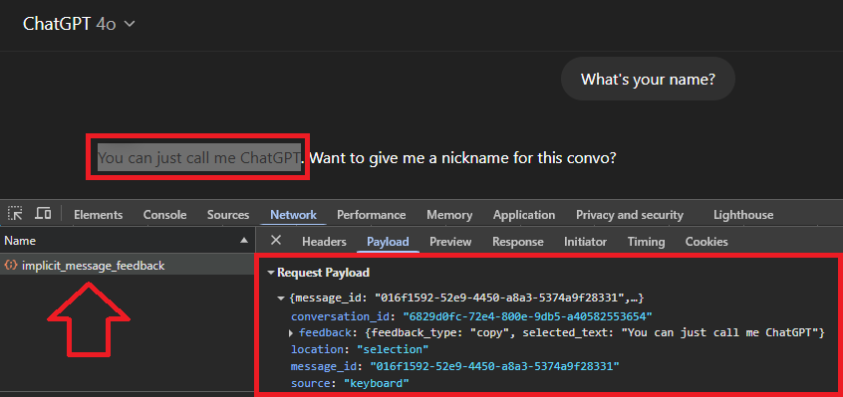
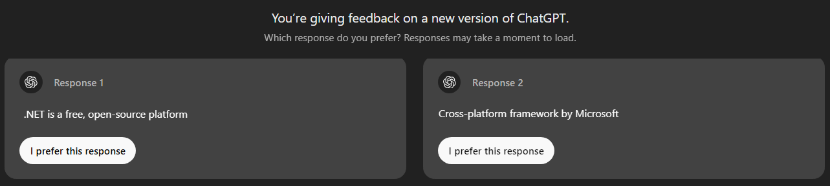
How AI improved so much recently?
1997
2017
AI first performance: Deep Blue beats Kasparov
Transformers by Google (translation)
2005
2020
Reddit, YouTube, Twitter, WhatsApp, Instagram…
COVID-19 Pandemic – Big data transformation
2007
2022
First iPhone
ChatGPT started “Reinforcement Learning”
2012
AlexNet won ImageNet Challenge (matrix ops on GPU)

Slide 10
Simply, how AI works…

Slide 11
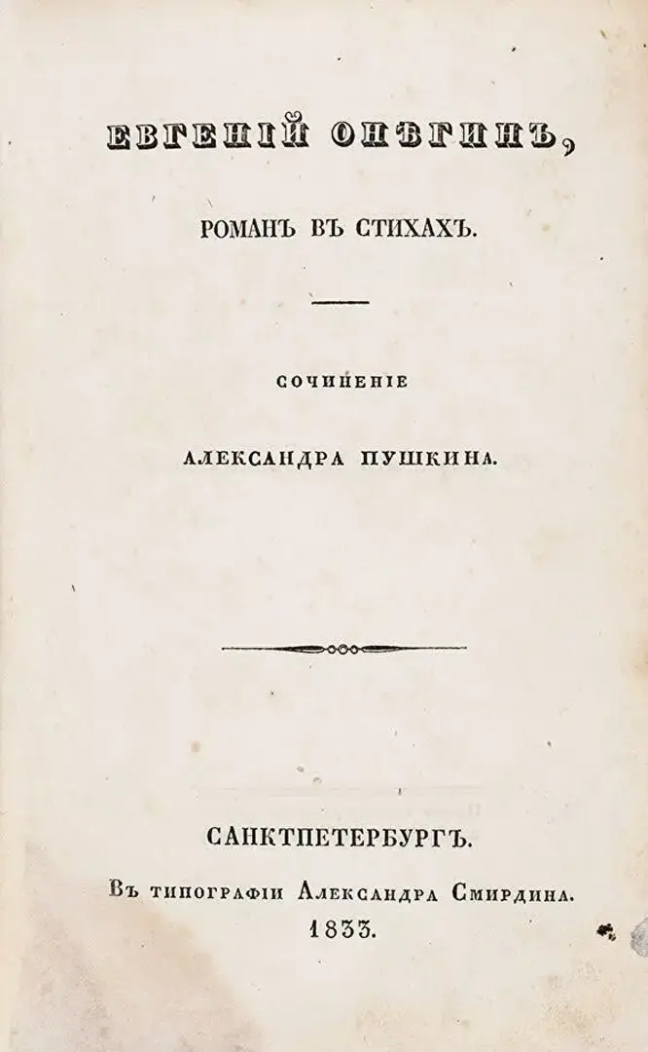
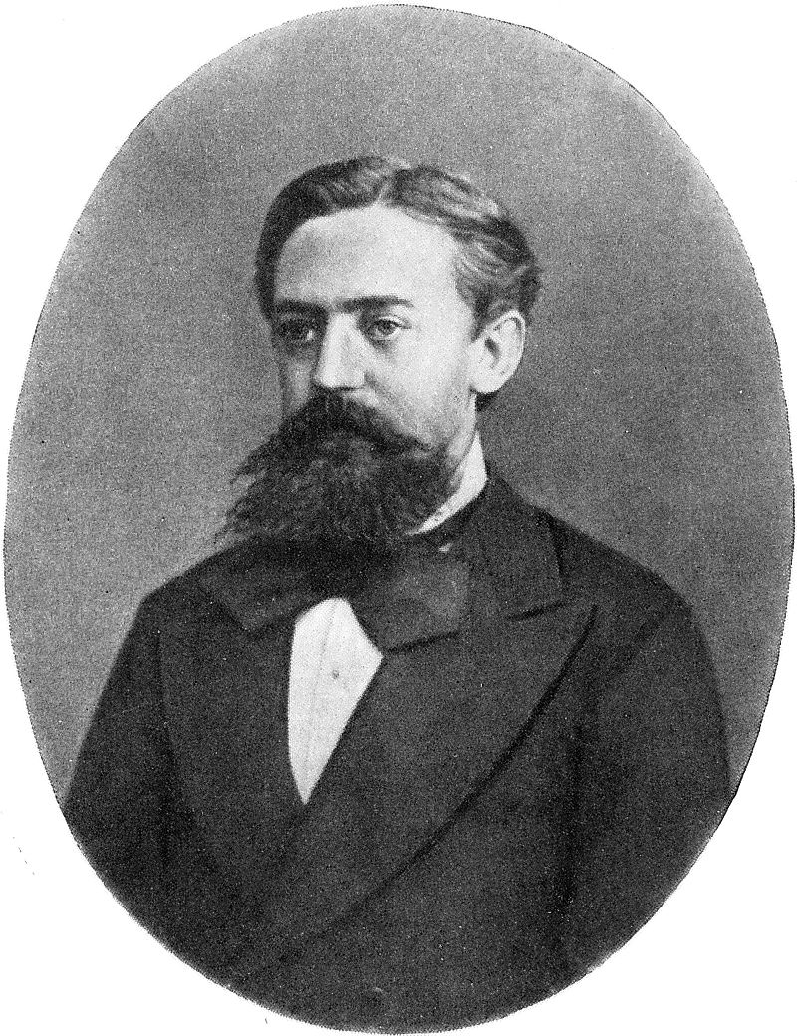
Markov Chains (1913) - The First Algorithm of Generative AI
Russian Language
Vowels: 43%
Consonants: 57%
English vowels:
a, e, i, o, u
Turkish vowels:
a, ı, o, u, e, i, ö, ü
Andrey Markov

Slide 12
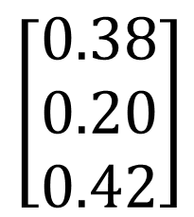
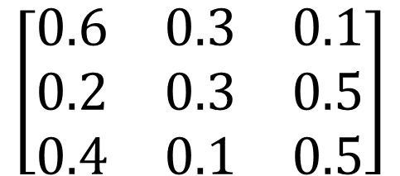
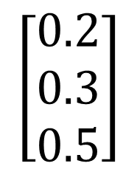
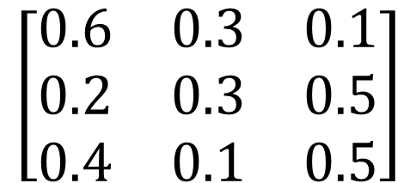
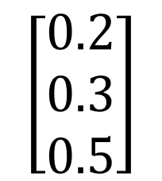
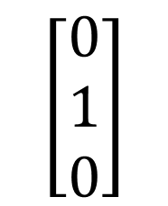
Probability Matrix
x | Sunny | Cloudy | Rainy
Sunny | 0.6 | 0.3 | 0.1
Cloudy | 0.2 | 0.3 | 0.5
Rainy | 0.4 | 0.1 | 0.5
Today is cloudy… Next 2 days?
DAY 1
$$\left[\begin{matrix}0 \\ 1 \\ 0\end{matrix}\right]$$
$$\left[\begin{matrix}0.6 & 0.3 & 0.1 \\ 0.2 & 0.3 & 0.5 \\ 0.4 & 0.1 & 0.5\end{matrix}\right]$$
$$\left[\begin{matrix}0.2 \\ 0.3 \\ 0.5\end{matrix}\right]$$
Sunny: %20
Cloudy: %30
Rainy: %50
Sunny
x
=
Cloudy
Rainy
DAY 2
$$\left[\begin{matrix}0.2 \\ 0.3 \\ 0.5\end{matrix}\right]$$
$$\left[\begin{matrix}0.38 \\ 0.20 \\ 0.42\end{matrix}\right]$$
Sunny: %38
Cloudy: %20
Rainy: %42
$$\left[\begin{matrix}0.6 & 0.3 & 0.1 \\ 0.2 & 0.3 & 0.5 \\ 0.4 & 0.1 & 0.5\end{matrix}\right]$$
Sunny
x
=
Cloudy
Rainy
Notes:
Token Predictor

Slide 13
2.1 - Markov Letter Matrix

Slide 14
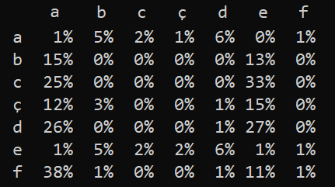
Turkish Letter Transition Probability Matrix
Output:
de
ded
dede

Slide 15
2.2 - Markov Word Matrix

Slide 16
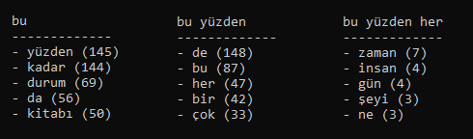
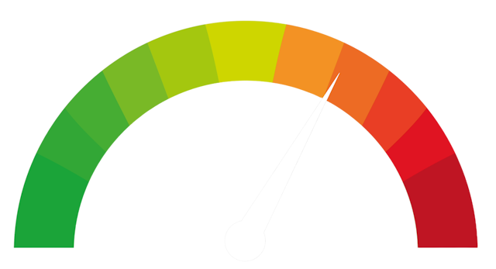
Language Text Generator (token predictor)
Stable
More predictable
Random
More creative
Temperature
0
1
2

Slide 17
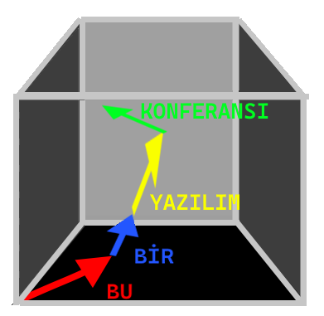
Embeddings - Understanding Similarity
A token is mapped to a vector using an embedding table.
“elma" → [0.12, -0.34, 0.98, ...]
+
User Text Input
RAG
tokens > vectors
[0.12, -0.34, ...]
LLM
vectors > tokens
Text Output

Slide 18
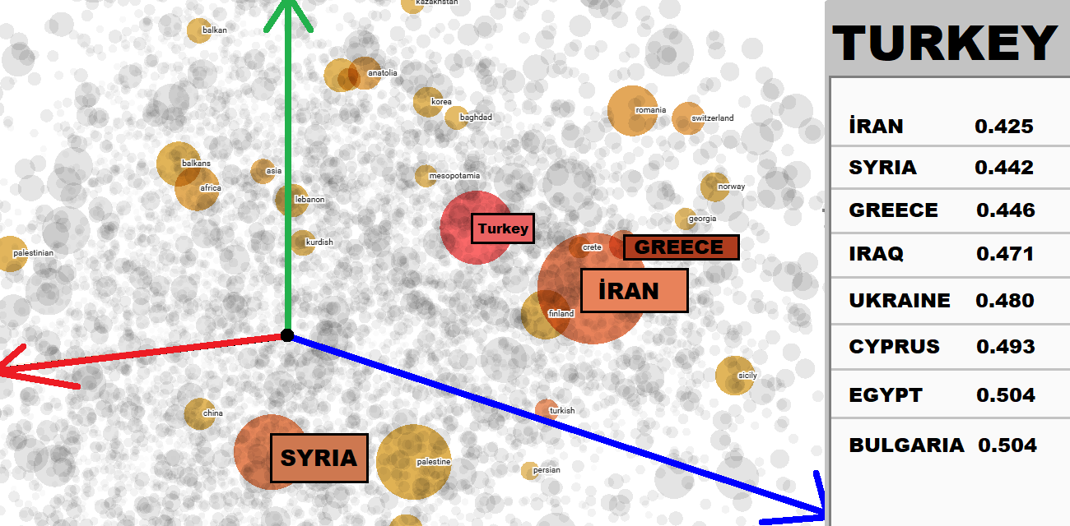
Notes:
https://projector.tensorflow.org/

Slide 19
3 – Classification with LocalEmbeddings

Slide 20
2+1 = ?
Tokenize
“2” “+” “1” “=” “?”
Identify Context
Mathematical Question
Basic √
Complex
Predict
Basic: Predicts via pattern matching (the most likely answer)
Complex: Write Python code (text generation) & evaluate
Output
Output
3
Don not blindly trust!

Slide 21



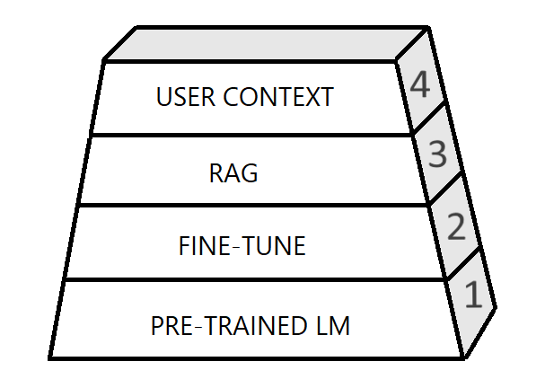
FINE-TUNING
Customizes model responses through additional training
Faster inference, no need for external lookups.
Best for constant domains Eg: legal, religion info
Requires costly retraining for updates.
RAG
Retrieves external data dynamically
No retrainin! Uses up-to-date data
Best for dynamic data, Eg: support chatbots
Slower inference due to retrieval step

Slide 22
4 - RAG

Slide 23
AI Integration Libs for .NET
🧠 Microsoft.SemanticKernel
⚙️ Microsoft.Extensions.AI
Complex AI Orchestration
Flexible
Extensible
Eg: Microsoft.Data.SqlClient
Standard Q&A and Chatbots
Easily change AI provider
Lightweight
Eg: Microsoft.EntityFrameworkCore.SqlServer

Slide 24
5 - Data Extraction

Slide 25
6 - Smart Inputs

Slide 26
7 - Vision: Detect Anomalies

Slide 27
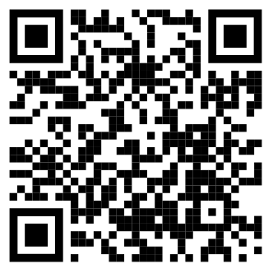



ALPER EBİÇOĞLU
https://twitter.com/alperebicoglu
https://github.com/ebicoglu
https://medium.com/@alperonline
github.com/ebicoglu/devnot_dotnet_25_konf

